Slide 1
PPE Workwear Why and How to Manage Quality
PPE Legislation
Contractual Agreement and Responsibilities
Who is responsible; Employer, manufacturer, service provider, wearer
Wearer application/task Risk Assessment
Fabric, construction, size and fit, special/additional requirements
Soil type and Laundry process
Quality Control, defect analysis, rewash, repairs; PERFORMANCE
Reviews with the customer; service quality and abuse

Slide 2
PPE Regulation – a reality check
PPE at work Regulations 1992; gradually enforced by 1996. Employers and Employees learned. Amend. 2002, HSE INDG174.
Latest amendment 2016 to the PPE Regulation 2016/425 effective April 2018 under EU legislation.
Contractual responsibility must be formalized.
Employer ultimately responsible, but Manufacturer? Service Provider? Wearer? EVERYONE IN THE SUPPLY CHAIN.
In-service issues must be communicated.
Shrinkage, soil retention, functionality, performance, repairs, justification for replacement, abuse and delivery.

Slide 3
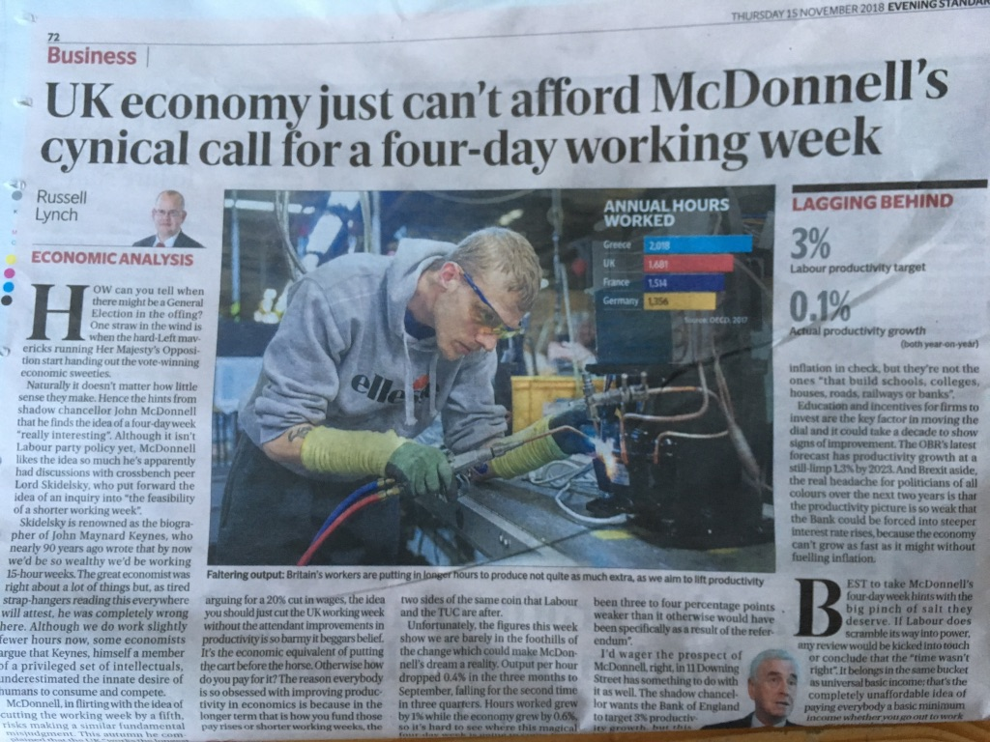
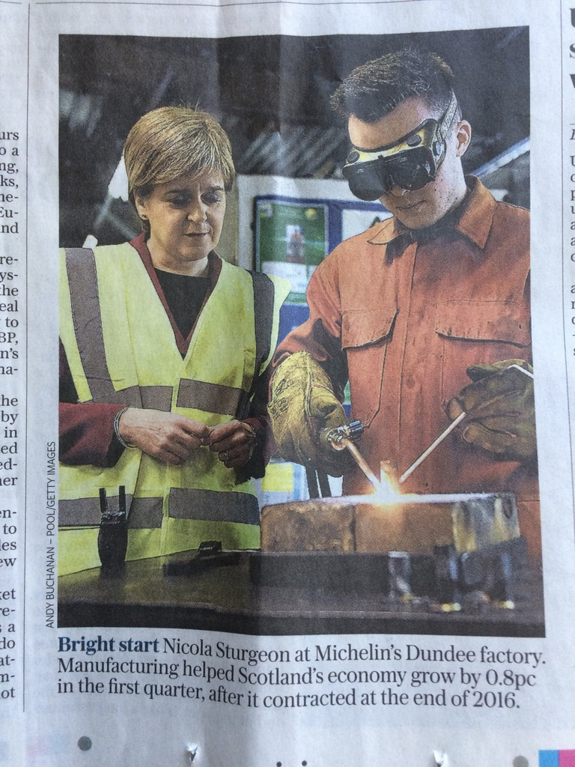

Slide 4
Typical PPE Classifications
ISO 11612 Heat & Flame
ISO 11611 Welding
ISO 20471 High Visibility
IEC 61482 Electric Arc (UV)
EN 13034 Chemical Splash
EN 1149 Electro-static
AND MORE?

Slide 5
Professional Service
Risk assessment for the activity/procedure
Technical advice must be provided to state the protection required
Garment supplier must provide instructions on functionality, use and maintenance
PPE should be the last resort
Employee involvement
Employer responsible for the supply and wear enforcement
PPE must be correct size and wearer trained/certified in its use
Wearer, Employer and Service Provider are all responsible
PPE must be available for use at all times and be fit for purpose
Service Provider must be made aware of any changes in application
Service Provider is ultimately responsible for maintenance and performance

Slide 6
Specialist Care
Soiled garment inspection; damage, processes record,
Soil type/degree analysis
Cleaning process and finishing process
Quality Control
Inspection and performance test
Defect analysis; Reject or Repair
Life in service recording
Have you taken it HOME to WASH?

Slide 7
EXTRACT; Company Policy on dealing with PPE garments
(Personal Protective Equipment)
The following procedures will be fully implemented by each Branch and Plant before 29th March 2002. You must make your own judgement as to whether each affected Customer is informed in writing, or by a visit as well.
Replacement garments will be issued and charged when a PPE garment is beyond repair.
Definition: “beyond repair”
It will always be a garment that has already had several repairs, or suffered one massive damage. It may also be where we would need to repair on top of previous repairs, or when it will take longer than 40 minutes to repair the garment.
Repairs to PPE garments will be completed in all cases in accordance with the current guidelines – irrespective of time required (up to a maximum of 40 minutes).
Where damage to a garment is caused by Customer abuse we shall charge Customers for the cost of repairs at a set rate per machinist minute (currently 30p per minute).
Definition: “Customer abuse”
Any unreasonable or repetitive damage. Weld spatter is always considered as Customer abuse because it can be avoided through the use of Primary protection (e.g. leather aprons).
Repairs for “fair wear & tear” damage will continue to be completed free of charge – irrespective of time required (up to a maximum of 40 minutes).
Definition: “Fair wear & tear”
An isolated and accidental tear, broken zips or fasteners should all be considered to be “fair wear & tear” - unless the damage is repetitive, or careless.
Chemical Resistant garments will be re-proofed during each of 4 consecutive weeks in February and November 2002 (and June 2003 etc). It is the Branch Managers’ responsibility to ensure that the garments are identified and sent to the Plant in the appropriate packaging. It is the Plant Managers’ responsibility to ensure that the re-proofing process is carried out.
With effect from 1st April 2002, regular independent checks on each Branches quality of PPE stock in circulation will be made - and reports sent to the Executive on a monthly basis.
Please sign and return a photocopy of this page to the Health & Safety Manager, Eastcote, to confirm that you have understood and begun to implement this procedure.
Signed………………………………………….. Branch/Plant…………………………
Date……………………………………………..

Slide 8
Repair Standard for Workwear
PRODUCT TYPE: ALL GARMENTS
This repair Standard replaces Issue B (Dec. 1998) and must be implemented immediately. The procedures and
standard of repairs being carried out will be audited as part of Health & Safety reviews.
REPAIR STANDARD FOR: ALL REPAIRS or ALTERATIONS
SPECIAL INSTRUCTIONS:
The intended size of a garment must not be changed as a result of any repairs.
The wearers safety must never be compromised.
The correct type and colour of material must always be used.
Patches must always be of the newest, strongest available material.
All repairs must aim to appear as reasonable in terms of Customer perception,
or safety.
Garments should reasonably fit the wearer. For PPE garments, this is a safety
issue and is a legal requirement. Therefore it may be necessary to shorten or lengthen sleeves and/or leg lengths from time to time.
Darning must not be applied over other darns.
The correct type of thread must always be used.
Polyfil 75s (which was Epic 80) must be used for all repairs, except Flame
Retardant repairs that involve exposed thread (darning or top-stitching) on the
front of garments exposed to high risk of excessive heat or flame.
When darning or top-stitching the front of Flame Retardant garments, Coats
Firefly (Nomex thread) must be used. Flame-Retardant includes garments made
from Proban Cotton, Proban Cotton Rich (e.g. Flamemaster), Vinex, Zirpro Wool,
MM1, or MM2. (Other fabrics or brand names may be used in future. If in doubt, please refer to Technical Department, or Procurement Department, for information).
Any garment which is considered to be beyond repair – or not “fit for purpose” –
should be referred to the Supervisor, or Manager, responsible for the garment
repair process. PPE garments that are not “fit for purpose” should be
withdrawn from service immediately a replacement is available.
NB Any garment made from Polyester/cotton, or Cotton Rich, that shows signs
of damage from Weld spatter – must be brought to the attention of the
Customer for replacing with Flame-Retardant (PPE) garments.
A copy of this page must be displayed at all times wherever Repairs or Alterations are carried out.

Slide 9
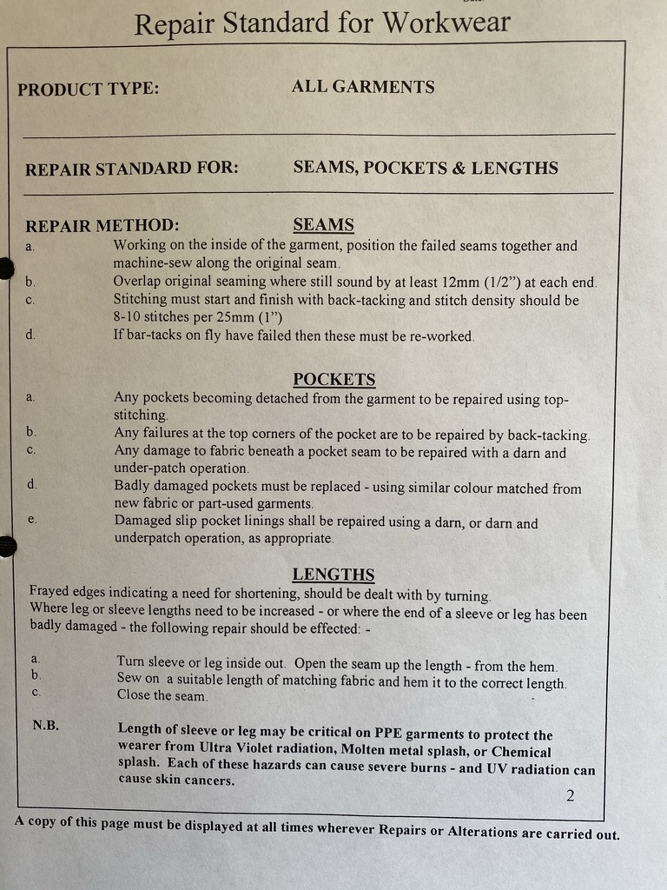

Slide 10
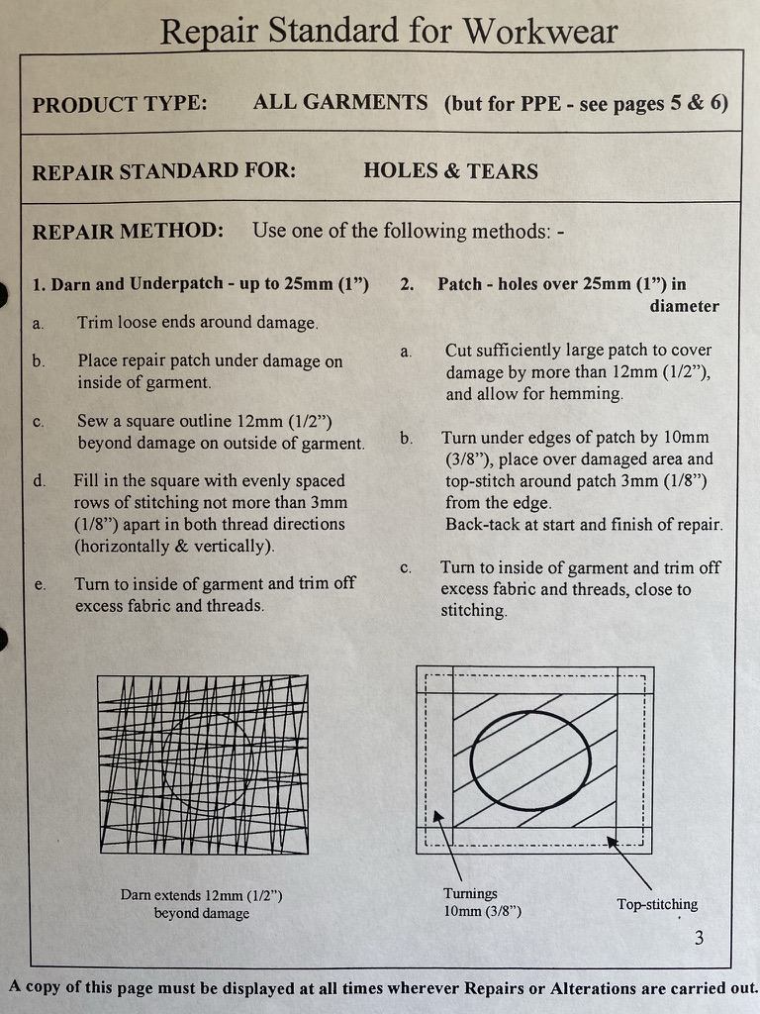

Slide 11
Sample Repair Standard for Workwear
PRODUCT TYPE: PPE GARMENTS
FLAME-RETARDANT
(EN470-1 & EN531)
REPAIR STANDARD FOR: HOLES & TEARS
MAIN POINTS to WATCH:
Avoid leaving holes that allow UV radiation from are welding to pass through.
Avoid creating traps for weld spatter, or molten metal splash to cling to.
Avoid darning with polyester thread (on the front of garments) because it can melt on
exposure to direct heat (causing severe burns as it clings onto the skin).
REPAIR METHOD: (check garment label for fabric details)
for PROBAN COTTON, or PROBAN COTTON RICH (e.g. FLAMEMASTER)
Garments must be repaired by patching which should be applied to the outside of the garment – either sewn on (as shown on page 2), or applied by heat-sealing as below. Darning can be used to repair low risk areas (e.g. the back of the garment).
for VINEX, ZIRPRO, MM1 & MM2 (EN 531 LEVELS D & E – FOUNDRY)
Holes & Tears are not to be darned on Foundry garments – unless under-patched and in low risk areas (e.g. back of garment). Flame Retardant thread must be used for all darning.
Patches should be applied to the inside of the garment for Foundry garments and can be either sewn on (see page 2), or applies by heat-sealing as below (Heat-sealing is not recommended for MM1 & MM2): -
Ensure that Heat-seal machine is at working temperature (200 degrees C).
Trim any loose threads around hole or tear.
Cut rectangular Repair Patch of similar fabric to size – giving overlap of at
least 12mm (1/2”) in all directions.
Cut Repair Film (Polymark repair film) to approximately 1 – 2 mm larger than
the Repair Patch.
Place garment on Heat-seal machine – position Repair Film over damage –
position Repair Fabric over Repair Film (allowing edges of Repair Film to show).
Ensure that Repair Fabric is right side up with the twill in the same direction
Apply pre-set pressure of at least 15lbs per Square inch for 20 seconds.
Repair Fabric Repair Film-
Repair film can be removed by re-applying the heat.

Slide 12
HIGH VISIBILITY GARMENTS
PLANT INSPECTION PROCEDURES
Various external factors including soiling, intensive wear, inappropriate washing, flame damage and advanced ageing of the garment can affect or deteriorate the properties of the retroreflective tape and fluorescent background material.
It is therefore necessary to check, after every wash and finish process, the performance of the tape using a 3M Confirm Verifier and the fabric using a graded swatch, as detailed below.
RETROREFLECTIVE TAPE TEST
Equipment required
Designated darkened area (approx. 5m x 0.7m).
3M Confirm Verifier.
3M 9920-retroreflective tape sample at minimum acceptable reflectance standard (mars), defined as 100 cd/lx/m² from EN 471 :1994 and of size 50x200mm.
Plant Logbook identifying Reject Garments stating all key information from Garment label.
Faulty PPE Garment repair tickets.
Reject bags for faulty garments.
Inspection Procedure
Hang the garment in a vertical position ideally in a darkened area or where there is minimal extraneous light which may affect the test result.
Stand approximately 5m away from the garment and hold the 3M Confirm Verifier close to the favoured eye, with the switch facing towards you, and switch on.
Aim the light beam at the garments retroreflective tape and compare its brightness, on the front and back of the garment, (by looking through the eyepiece) against that of the reflective tape sample (mars).
If the reflected light from the garment tape appears to be above the mars sample, then its performance can be deemed satisfactory, but if it is below, then the garment has failed and should be REJECTED.
If the retroreflective tape is not securely sewn to the garment, the garment should be REJECTED.
REJECTED garments must be folded and placed in the garment reject bag
Reporting procedure
Rejected garments should have their customer details entered into the reject Logbook.
Rejected garments should be fitted with a ‘Faulty PPE Garment’ repair ticket, identifying the failure.

Slide 13
FLUORESCENT FABRIC TEST
Equipment required
Designated well-lit area.
Fluorescent fabric sample at minimum acceptable fluorescence/luminance (mafl) from EN 471 :1994 and of size (290x200mm)
Plant rejects Logbook.
Faulty PPE garment tickets.
Inspection procedure
Hang the garment in a vertical position in a well-lit area.
Stand approximately ½ metre away from the garment and compare its fluorescence, on the front and back of the garment, against the mafl sample.
If the visible fluorescence of the garment fabric appears to be higher than the mafl sample, its performance can be deemed satisfactory, but if less then it should be REJECTED.
Reporting procedure
Rejected garments should have their customer details entered into the reject Logbook.
Rejected garments should be fitted with ‘Faulty PPE garment’ repair ticket, identifying the failure.
If at any stage you are unsure of any garments PASS or REJECT quality refer to your supervisor/manager
N.B.
In respect of both tape and fabric it must be stated that the aforementioned criteria must obtain to no less than 90% of the total area being inspected. i.e. partial staining of the fabric or damage to the tape up to 10%, is acceptable.

Slide 14
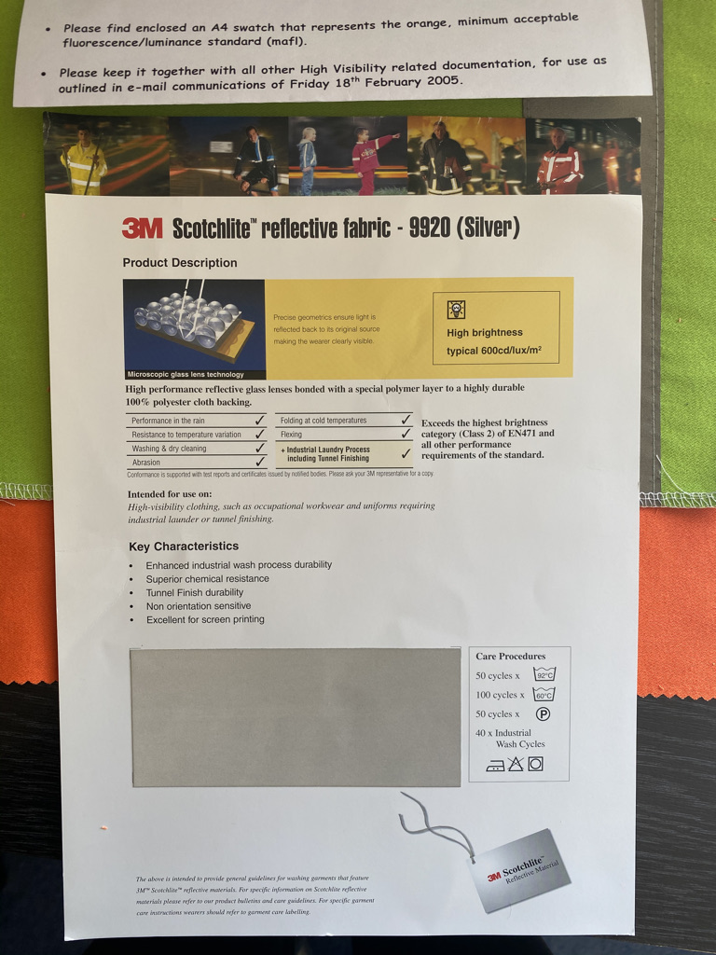

Slide 15
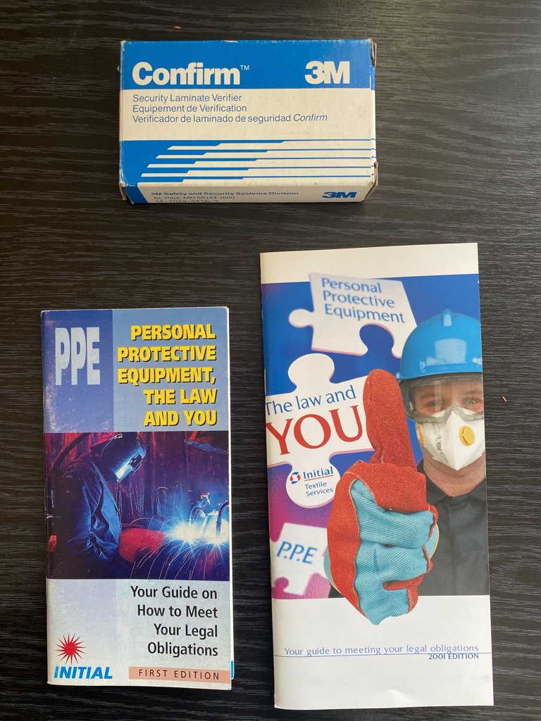

Slide 16
PLANT RECORD OF CHEMICAL RESIST GARMENTS (RE PROOFING SCHEDULE)
RECEIVED FROM BRANCH________________________
COMPANY NAME _________________ |  |  |  |  |  | ADDRESS_______________________ |  |  |  |  |  |  |  | DAC_________
 | Garment | Garment |  |  |  |  |  |  |  |  |  |  |  |  |  |  |  | Garment reprooofed
Employee name | Type | Number | 1 | 2 | 3 | 4 | 5 | 6 | 7 | 8 | 9 | 10 | 11 | 12 | 13 | 14 | 15 | Yes/No |  | Date

Slide 17
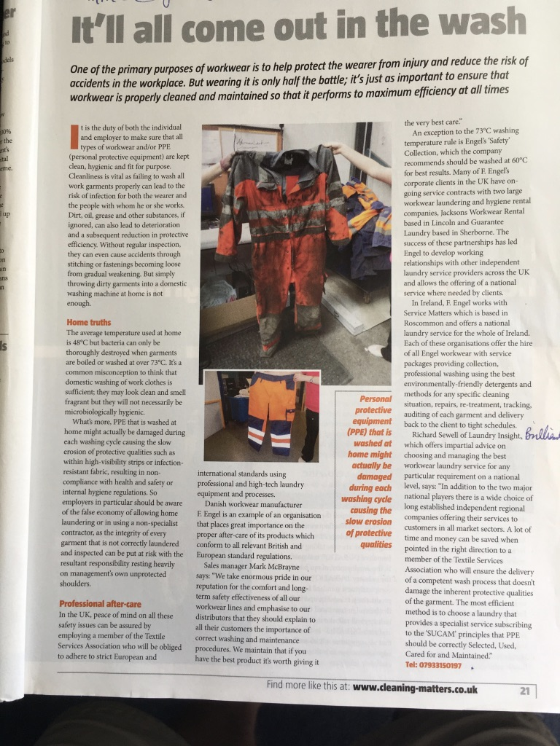
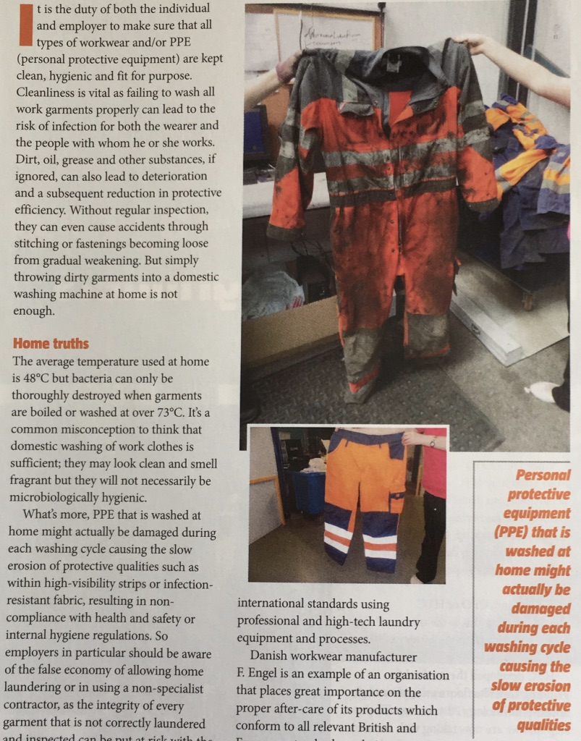

Slide 18
Closing the Circle
RESPONSIBILITIES
MANAGE THE SERVICE
MAINTAIN PERFORMANCE
COMMUNICATATION BY ALL PARTIES
MAKE IT WORK SUCCESSFULLY
INTRODUCE DEVELOPING TECHNOLOGY
ENSURE WEARER SAFETY
CUSTOMER RETENTION THROUGH CONFIDENCE
PROMOTE THE RENTAL SERVICE BY EXAMPLE

